Slide 1


Final Report: Formula One dataset
By Ava Powers

Slide 2
Why I chose the dataset?
Dataset about Formula 1 (international racing sport), grew up watching it with my dad, interesting from data science standpoint
Info about drivers, constructors, the team which driver/constructor associated, # of points driver/constructor won in season, and overall rankings for the racing seasons 1950-2021

Slide 3
Research Questions and Other Analyses Conducted
Research Questions:
  Which teams won the most constructor's championships?
  Can you predict results of 2022 constructor's championship using data from 1950-2021?
Other analyses:
  Correlation between drivers nationality and team's nationality?
  Do certain drivers get certain positions consistently?
  Do certain drivers get similar point amounts across seasons?
  Which nationalities win the most amount of points?
  Which nationality of driver of most prominent in Formula One?

Slide 4
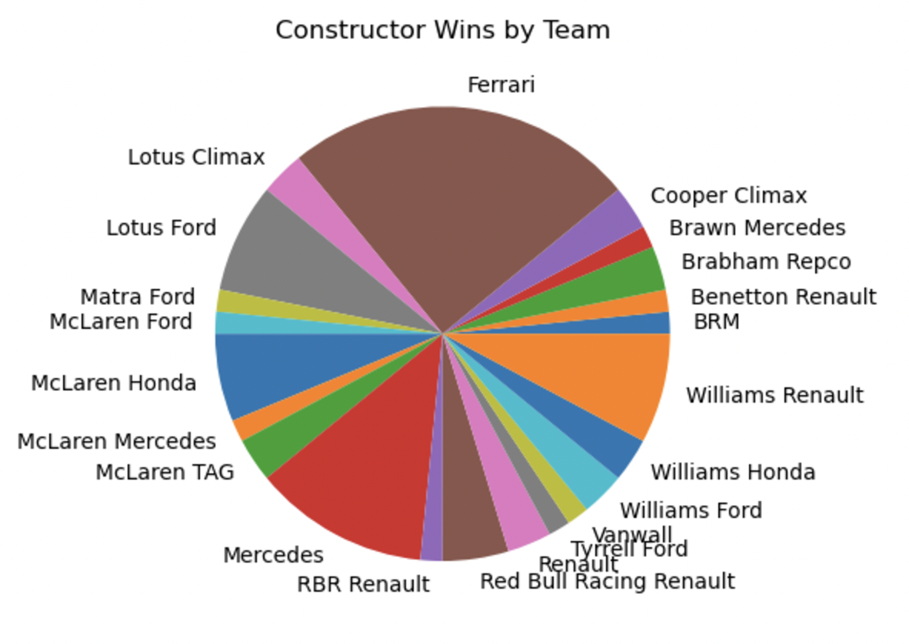
First analysis: Which teams have won the most constructors championships?
Create mask to only show me the teams which had a ranking or “Position” of “1”, or first place, in each season
Create cross tabular calculation to group together the “1” positions from each team so that I was able to make a visualization of the data by means of a pie chart.
Most wins: Ferrari

Slide 5
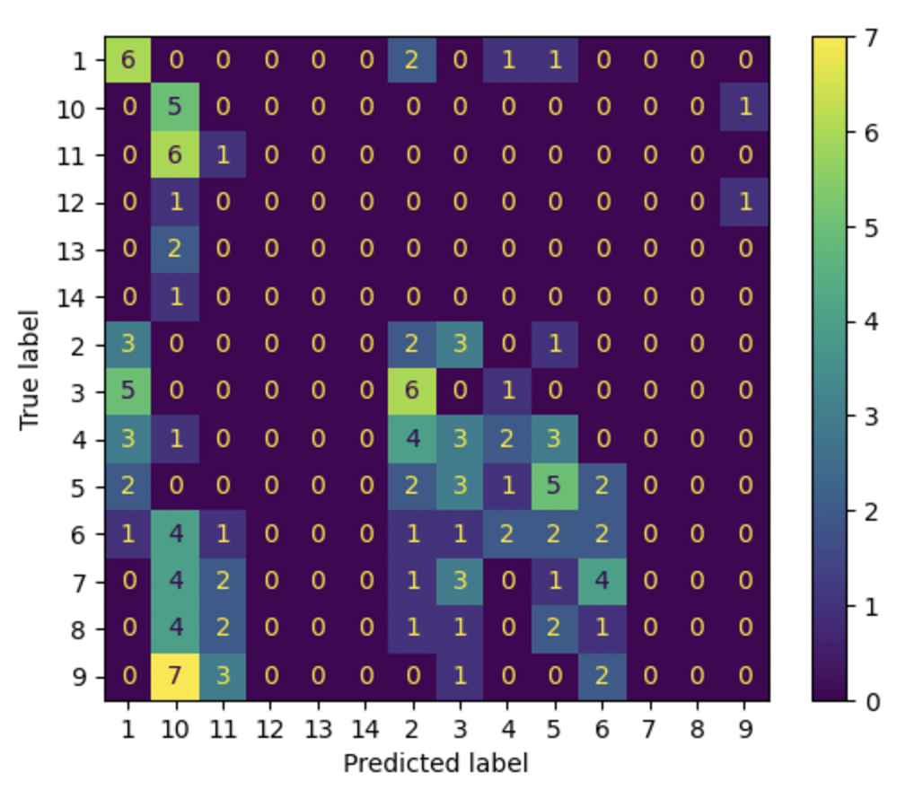
Second Analysis: Can you predict 2022 constructors championship results using 1950-2021 championship data?
Split into training and test data to train algorithm
Algorithm trained and made prediction about results
Confusion matrix was created to determine how accurate the prediction was.
Results: *shrugs* (no)

Slide 6
Third Analysis: Correlation between driver's and team's nationality
Create cross tabular to group together the columns with driver’s nationality and the teams.
Conduct Chi-Squared Test to determine if there was any correlation present.
Result: literally 0 correlation (p=0.0)

Slide 7
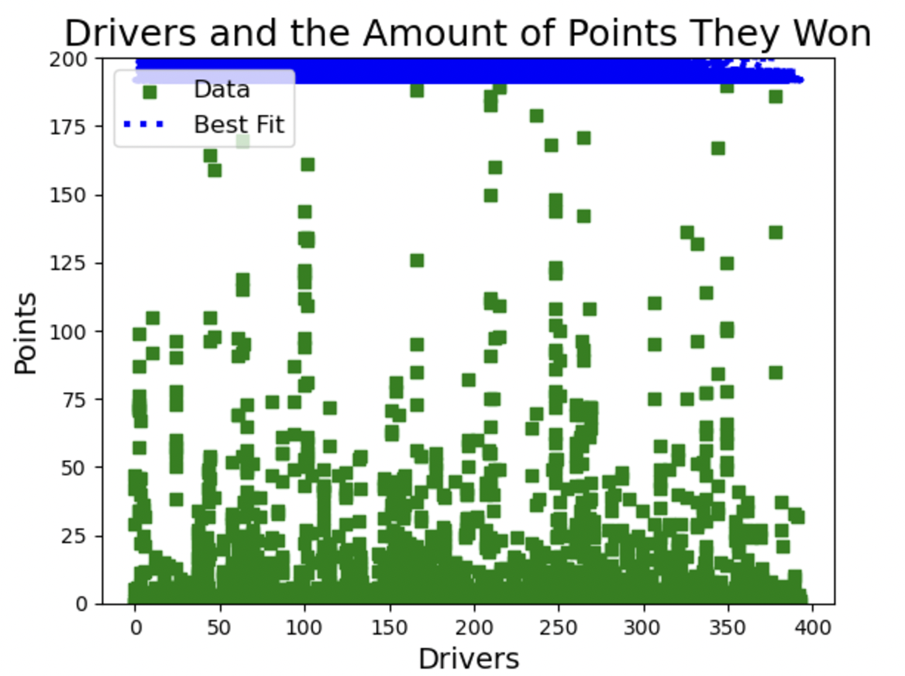
Fourth Analysis: Correlation between Drivers and positions consistency in season?
Converted “Drivers” into list of codes to make data numerical.
Conducted Pearson’s and Spearman’s Correlation test to determine if there was any correlation between the drivers and their total seasons points.
Then, visualized data (this didn’t end well)
Results: No correlation (Spearmans = -0.025, Pearson's=0.048)

Slide 8
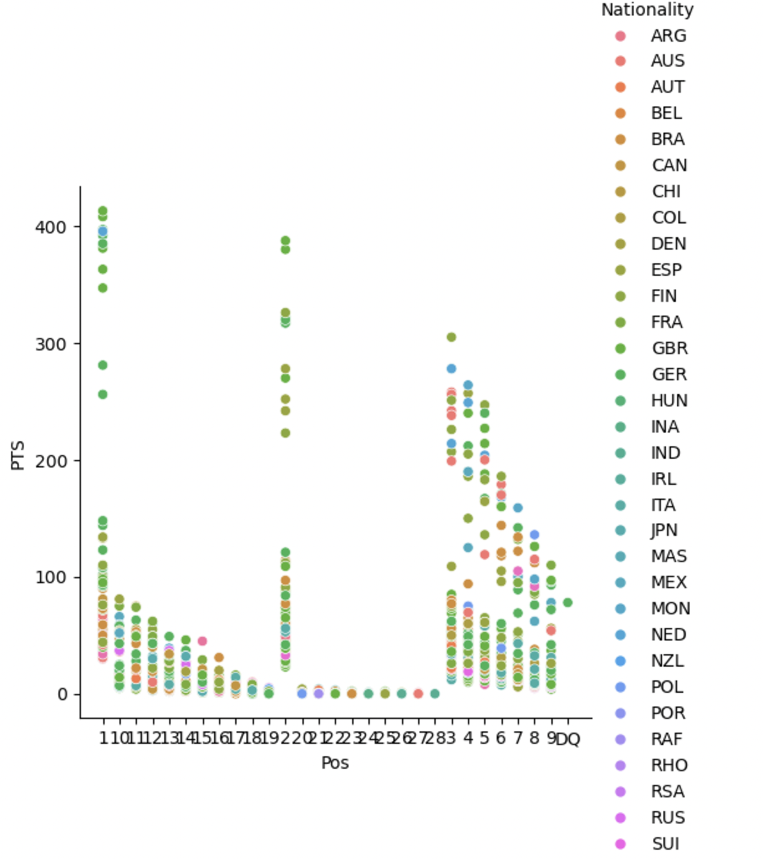
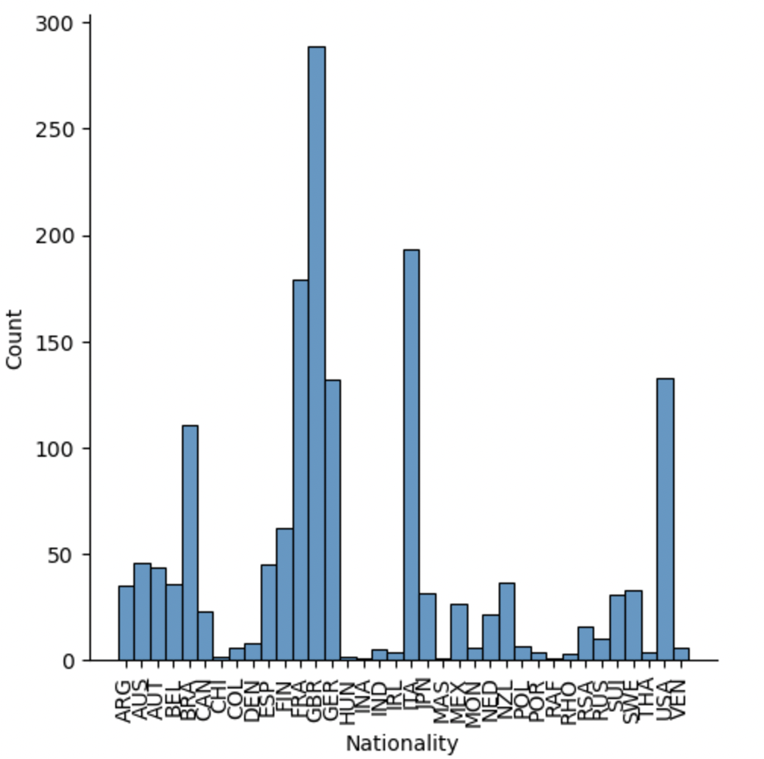
Fifth and Sixth Analyses: Which nationalities of drivers win the most points? Which nationalities of drivers are most present in F1?
Both used Seaborn notation (Relationship Plot and Distribution plot respectively)

Slide 9
Final Thoughts
Analyses very difficult
Difficulty in making predictions when it comes to sports such as Formula One with as many external factors contributing to the results (ex. Crashes, penalties, regulation violations resulting in point docking, etc.)
Irritating results, but this happens in data analysis
Notes:
- Didnt end well, difficult to make such predictions with an unpredictable sport like F!, whikle this was irritating, I still learned a lot in conducting this analysis, and hope you could learn a little bit as well

